Slide 1





SUPERMARKET
SALES ANALYSIS
Prerna Phulwaani

Slide 2




Project Overview
This project focuses on analyzing supermarket sales data using SQL. It began with formulating specific queries to extract meaningful insights from a dataset,
The primary objective is to demonstrate how SQL can be utilized for data analysis and decision-making.
Each query is designed to answer practical business questions that can help a supermarket improve operations and maximize profit
Dataset Source: https://www.kaggle.com/datasets/bravehart101/sample-supermarket-dataset

Slide 3

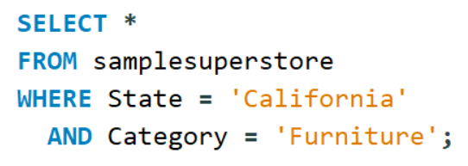

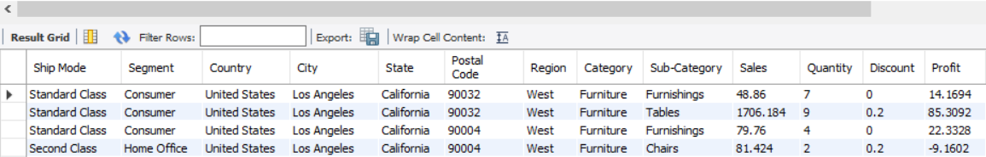
List all records from California where the Category is 'Furniture'

Slide 4


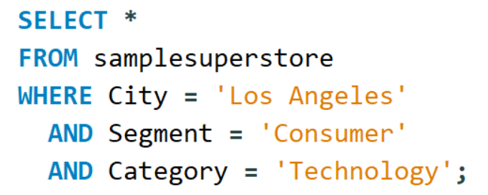

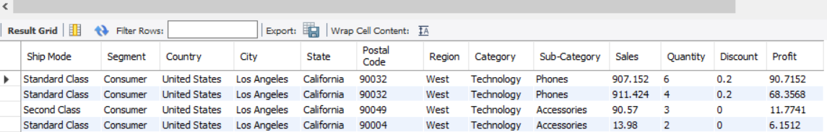
Get all records from Los Angeles where Segment is 'Consumer' and Category is 'Technology'.

Slide 5
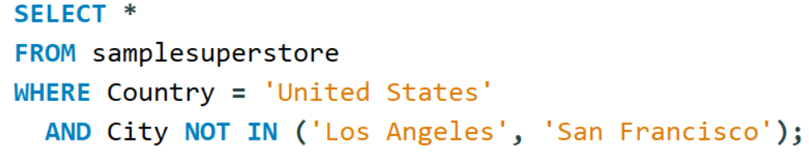
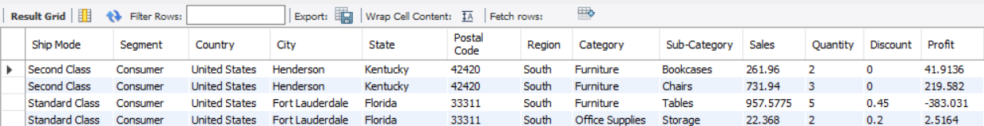
Find all entries from ‘United States’ excluding cities ‘Los Angeles’, ‘San Francisco’.

Slide 6
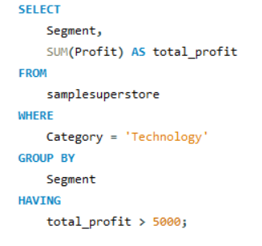
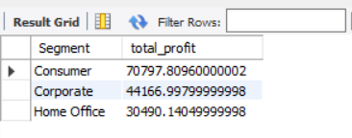
Display the total profit for each segment in the “Technology” category where the profit exceeds 5000.

Slide 7


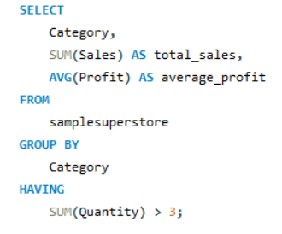

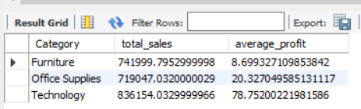
Display the total sales and average profit for each category where the quantity sold is greater than 3

Slide 8
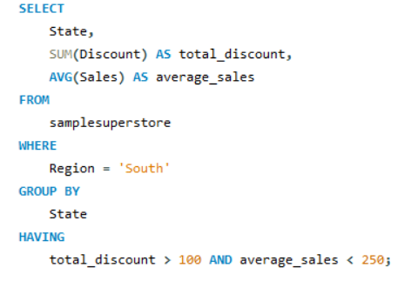
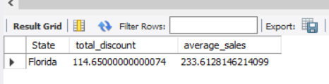
List the states from the ‘South’ region where the total discount exceeds 100 and the average sales is below 250

Slide 9
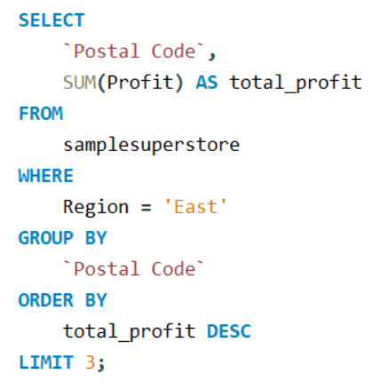
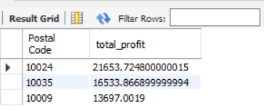
List the top 3 postal codes by total profit in the 'East' region.

Slide 10
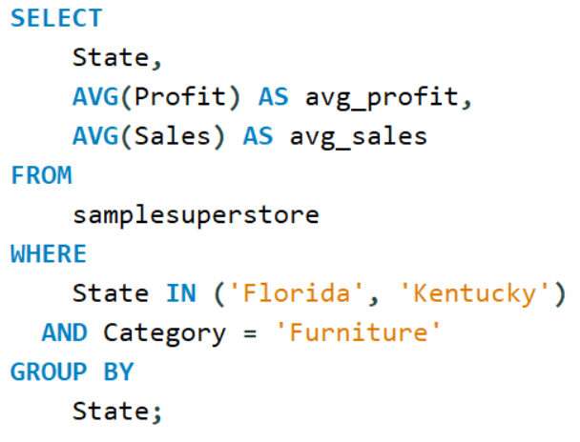
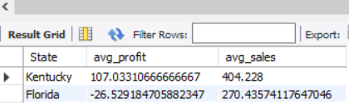
Compare average profit and average sales between Florida and Kentucky for the 'Furniture' category.

Slide 11
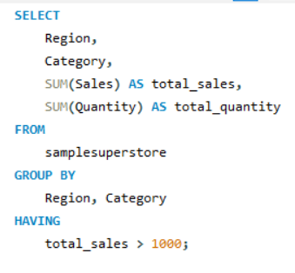
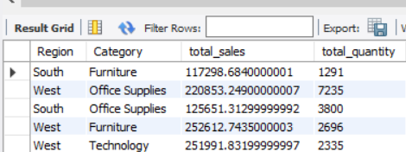
For each region and category, display the total sales and quantity sold but only where total sales exceed 1000

Slide 12
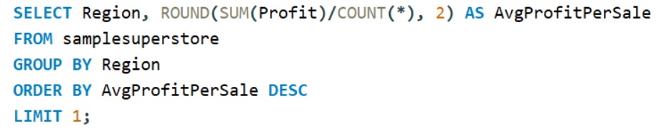
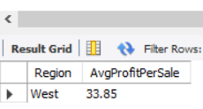
Find the Region with the Highest Average Profit per Sale

Slide 13
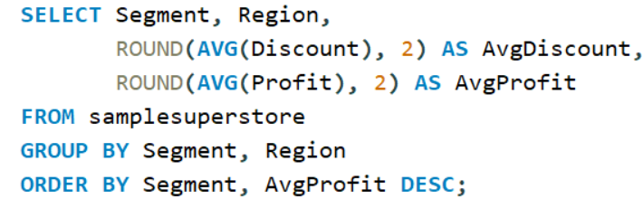
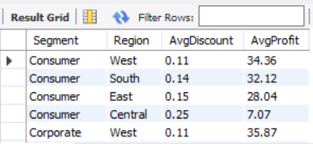
Compare Average Discount and Profit Across Segments and Regions

Slide 14
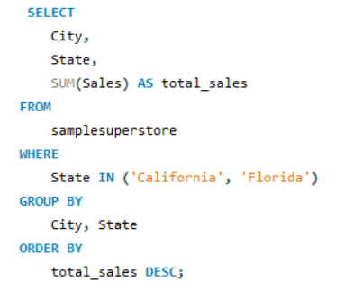
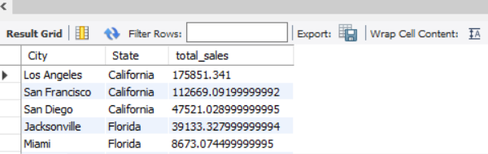
Compare total sales between cities in California and Florida, displaying city, state, and total sales.

Slide 15
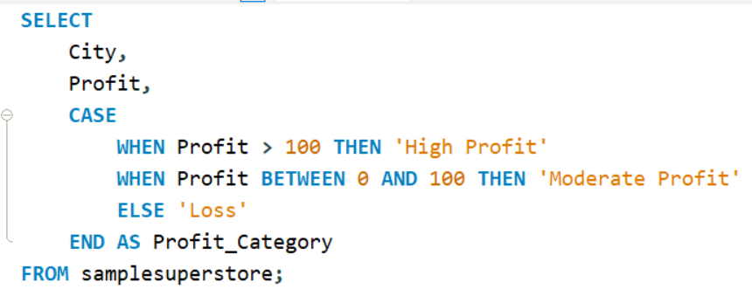
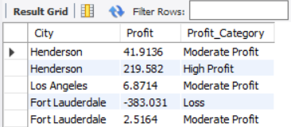
Create a new column that categorizes orders as ‘High Profit’, ‘Moderate Profit’, or ‘Loss’.

Slide 16
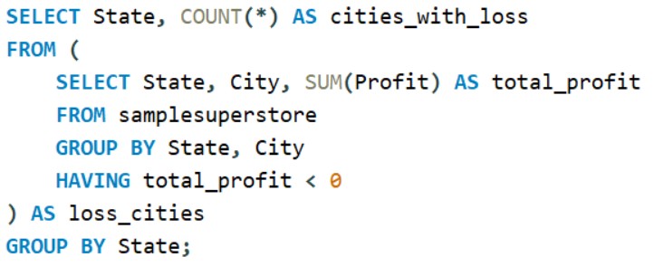
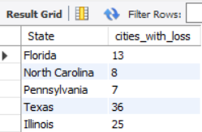
Show how many cities in each state had overall negative profit.

Slide 17
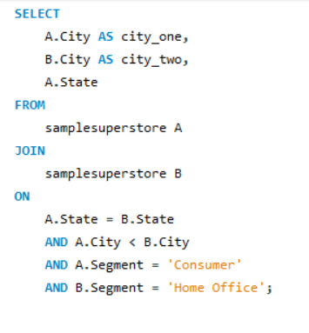
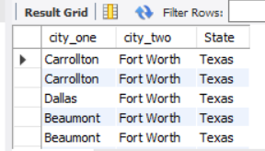
list pairs of cities in the same state where one city belongs to the ‘consumer’ segment and the other to the ‘home office’ segment

Slide 18
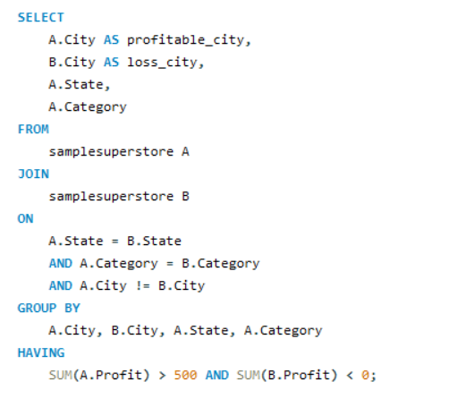
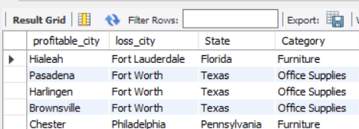
Find pairs of cities where one city has profit > 500 and the other < 0, but both are from the same state and category.

Slide 19
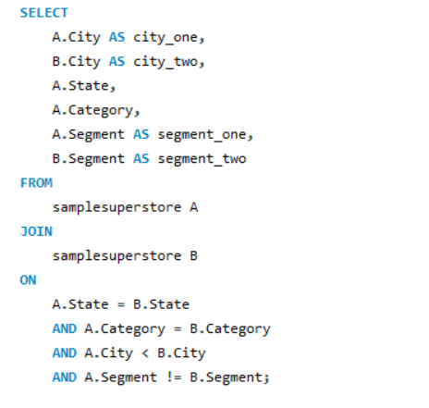
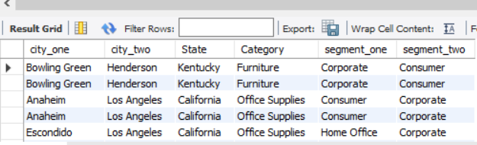
create a self-join to list pair of cities in the same state and category but with different segments

Slide 20
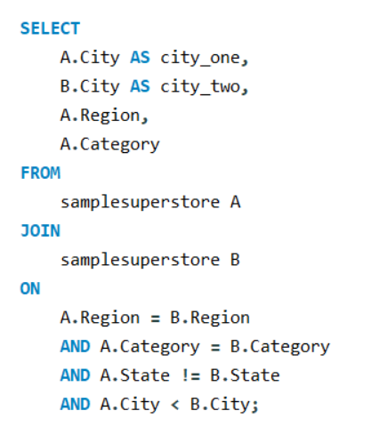
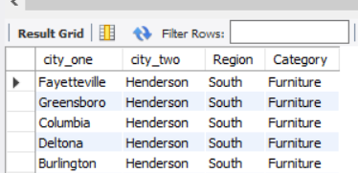
Find combinations of cities in the same region and category but different states.

Slide 21
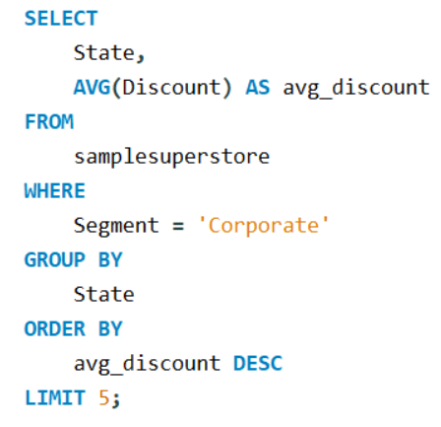
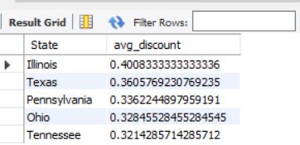
List the top 5 states with the highest average discount for the 'Corporate' segment.

Slide 22
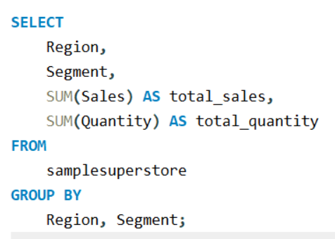
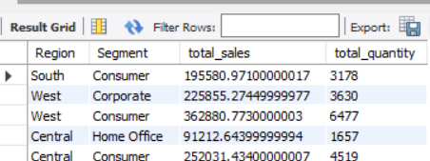
Display total sales and total quantity for each Region and Segment combination.

Slide 23
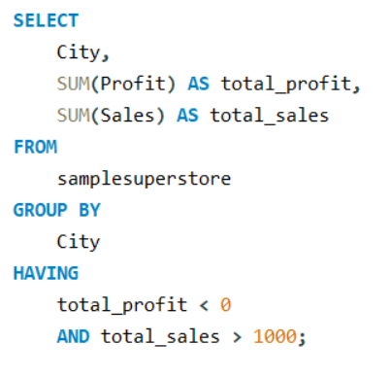
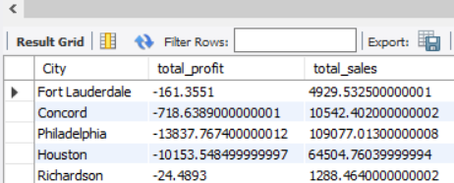
Find the cities where total profit is negative but total sales are above 1000.

Slide 24
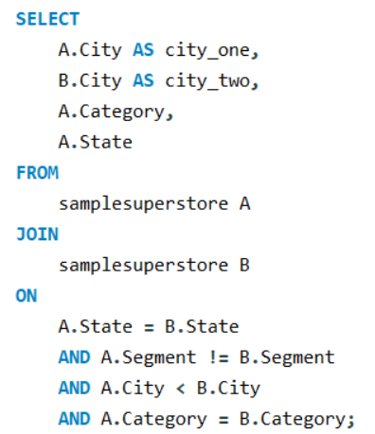
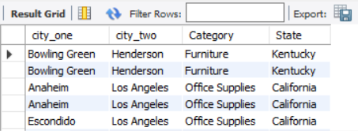
Find combinations of rows from the same state but different segments, showing both cities, category, and the common state.

Slide 25
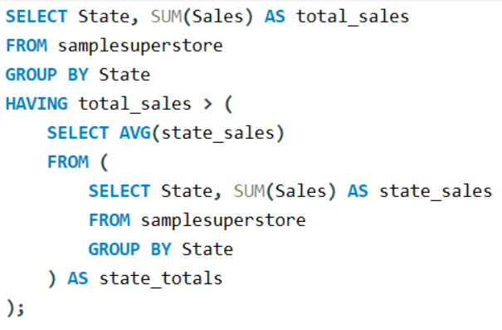
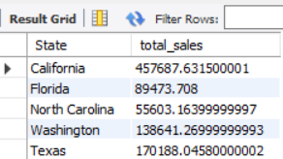
List states where total sales are above the average total state sales.

Slide 26
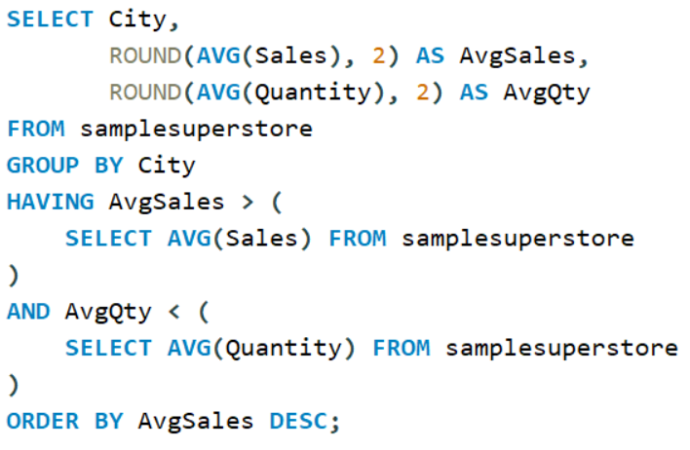
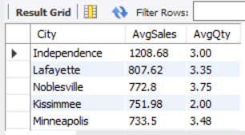
Identify Cities with Higher Than Average Sales and Lower Than Average Quantity

Slide 27
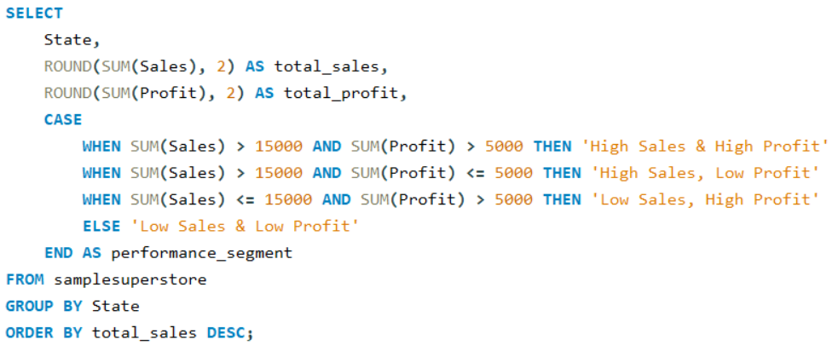
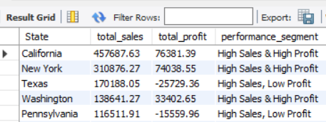
classify each state based on total sales AND total profit thresholds.

Slide 28

Project summary:
Executed and analyzed 25 SQL queries on the SampleSuperstore dataset.
Filtering with WHERE
Grouping data using GROUP BY and HAVING
Sorting and limiting results
Applied the self join technique to identify patterns which helped reinforce how relational logic can be applied even within a single table when needed.
Using aggregate functions like SUM(), AVG(), COUNT(), ROUND()

Slide 29

Final thoughts:
Sustainable Sourcing
This project helped me gain practical experience in data analysis using SQL. It showed how structured queries can turn raw sales data into clear, decision-ready insights. It also improved my ability to write clean, efficient queries for both simple lookups and deeper business analysis. Every query provided a new perspective on how structured data can reveal business trends, such as high-profit cities, underperforming states, or customer behavior across regions.
hnh

Slide 30
Thank You

